Slide 1
FWIP adVenture
Presentation Overview
Team Roles
Selected Topic
Why we chose the topic
Description of source data
Technologies that will be used
Questions we hope to answer

Slide 2
Team Roles
Square: Paul Isenberg
Triangle: Irina Tilak
Circle: Fahima Muthuvappa
X: Winston Shih

Slide 3
Selected Topic
After some extensive searches through Kaggle, we settled on Startup Investments data. The majority of the team has a background in finance and the dataset piqued our interest. Also, after this course the majority of us want to pursue a career and this might steer us in the direction of what types of companies to join or avoid. In addition, we felt that we could apply machine learning technologies after cleaning and merging the data. The csv’s each have at least one primary key that should allow us to combine the datasets for when we start preprocessing.
Notes:
We selected it because we can apply machine learning technologies, cleaned merged, applied, job hunt-what companies to avoid

Slide 4
Description of Source Data
11 csv’s
CSV’s contain
Acquisitions
IPO’s
Degree level of individuals in startup world
Funding
Location
Primary Keys

Slide 5
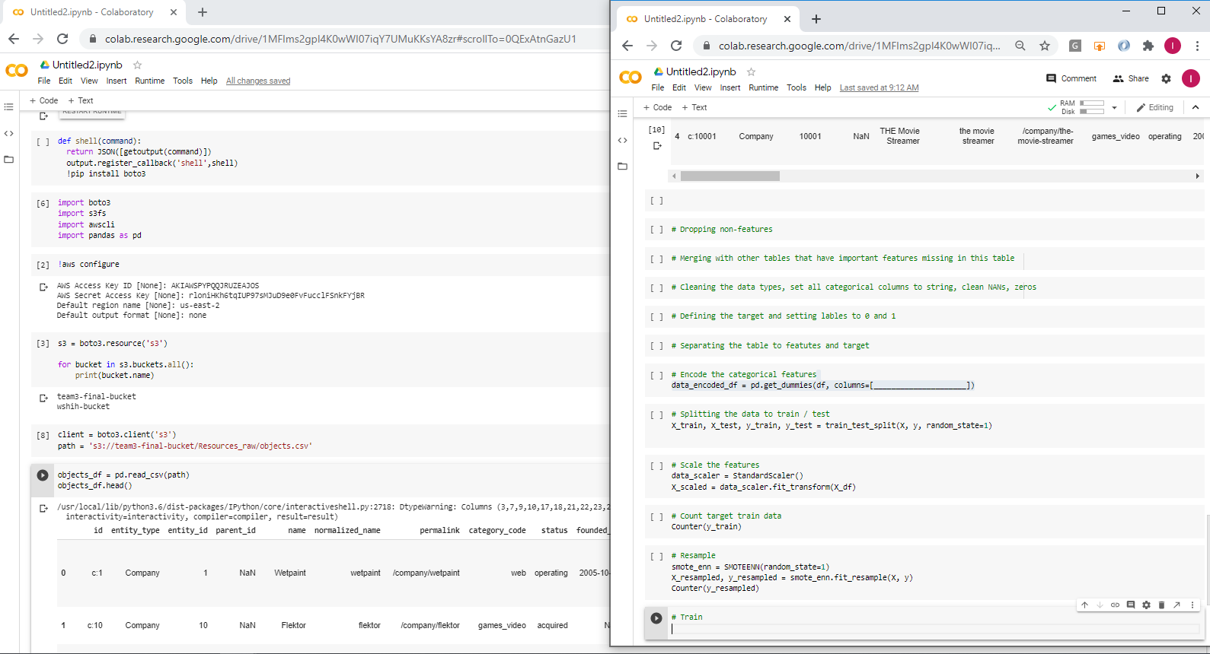
Accessing the Data
The dependencies we’ll be using to directly connect to the S3 bucket are boto3, s3fs, and awscli.

Slide 6
Mockup of Commands
These are the preliminary steps we will take to process our datasets before applying machine learning.

Slide 7
Technologies
AWS S3
GitHub
Jupyter Notebook or Google Colab
PostgreSQL/pgAdmin4
Supervised Machine Learning
Neural Networking
Tableau
Leaflet
Slack/Zoom

Slide 8
Questions We Hope to Answer
With machine learning techniques we would want to know:
What attributes lead to a startup failure?
With analysis and visualization we would like to find out:
What does it take to be successful? Any correlation with:
How much time
Education level
Location
Industry
ROI for investors
Investments vs Valuation
Notes:
We hope to use machine learning to answer these questions

